Slide 1
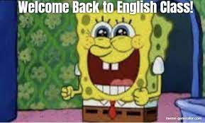

Slide 2
Associating words with general groups
Colombian government :
Social medias:
Sexual harrasment :

Slide 3
Femicide:.
Covid- 19 :
Infidelity:

Slide 4
Warm- up
WRITE AN EVERY DAY ROUTINE: 5 line maximum. DONE
REPEATED ACTIONS: ( SOMETHING THAT YOU DO EVERY SINGLE DAY):
ANDRE GOES TO THE MALL
JESUS TAKES HIS VIRTUAL SESSIONS
CAMI WATCHES ANIMES
EVENTS:
MAFE TURNS YEAR EVERY MARCH 7TH
CHRISTMAS IS ON 25TH DECEMBER
HALLOWEEN IS ON 31TH OCTOBER
HOLY WEEK IS IN MARCH AND APRIL
SAINT VALENTINES IS ON FEBRUARY THE 14TH

Slide 5
Keimy´s routine
In the morning Evening
Eats her breakfast SHE PLAYS ON HER CELLPHONE
Does some Readings SHE HAS A DINNER
Listening to music SHE TAKES HER CLASSES
SHE GOES TO SLEEP
the afternoon
Takes some lunch
Does her activities
Watches tv.

Slide 6
JASSIF´S ROUTINE
IN THE MORNING EVENING
HE TAKES HIS BKEAKFAST WATCHES TV
HE TAKES SESSIONS TAKES HIS DINNER
TAKING A SHOWER GO TO THE BED AND SLEEP
GOES TO THE GYM
AFTERNOON
TAKES LUNCH
TAKES SESSIONS AGAIN
LISTEN TO MUSIC
TAKE A NAP

Slide 7
WARM- UP
GENERAL FACTS: THE SUN RISE FROM THE EAST
THE EARTH IS ROUND
THE WATER WETS
THE SUN SHINES EVERYDAY
THE BLOOD IS RED
INSTRUCTIONS: OPEN THE DOOR, CLOSE THE DOOR AFTER LEAVING, ADD SALT TO THE SOUP, INSERT YOUR CARD
SCHEDULED EVENTS: THE ENGLISH CLASS STARTS AT 6 O CLOCK TUESDAY AND THURSDAY. THE CURFEW STARTS AT 10 PM . MEDICAL APOINTMENT IS AT 7 AM .

Slide 8
Class order
Dynamic : Make the longest Word
Summer : Saturday, umbrella, mother, Monday, Easy, Ready.
Computer : Cat, open, music, play, united, tomatoe, eraser, rain.
Speaker : STAR, PINEAPPLE, ELEPHANT, APPLE, KISS, EARTH, READ
Professor : PENCIL, ROSE, ORANGE, FLY, EGG, SISTER, SPIDER, OBEY, ROAD.

Slide 9
Fruit: FACE, RABBIT, UNCERTAINLY, IGNORE, TIME
Cellphone: Car, END, LUNCH, LUCK, PHONE, HOLIDAY, OBSERVE, NICE, EAT
Pillow: PARK, IMAGINATION, LIKE, LOVE, OCTOPUS, WORK
People: Photo, early, opportunity, power, lion, earn.
Gamer: GOOD, AMAZING, MONEY, ELECTRONIC, RED
Window: WAITER, ICE, NURSE, DOG , DARK, OBTAIN, WAIT.

Slide 10
PERMANENT DESIRES
I LIKE PLAYING VIDEOGAMES EVERY SINGLE NIGHT
I LIKE TO SEE MOVIES AT NIGHT
I LIKE GTA FROM PS2
I LIKE TO PASS THE EXAMS

Slide 11
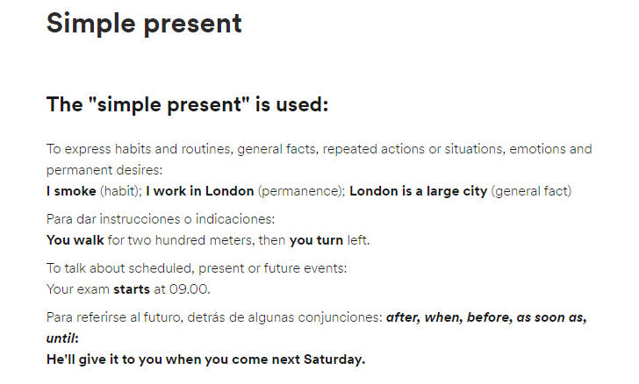

Slide 12


Slide 13
Examples
Habits and routines
He drinks tea at breakfast.
She only eats fish.
They watch television regularly.
Events and repeated actions
We catch the bus every morning.
It rains every afternoon in the hot season.
They drive to Monaco every summer.

Slide 14
General facts
Water freezes at zero degrees.
The Earth revolves around the Sun.
Her mother is Peruvian.
Instructions or indications
Open the packet and pour the contents into hot water.
You take the No.6 bus to Watney and then the No.10 to Bedford.

Slide 15
Scheduled Events
His mother arrives tomorrow.
Our holiday starts on the 26th March
Future constructions
She'll see you before she leaves.
We'll give it to her when she arrives.

Slide 16
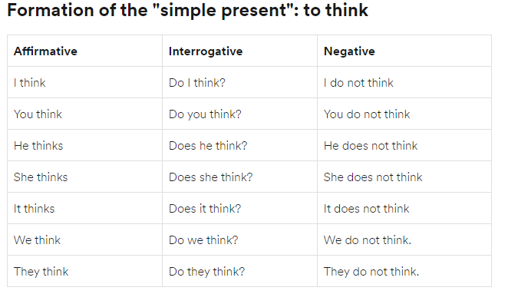

Slide 17
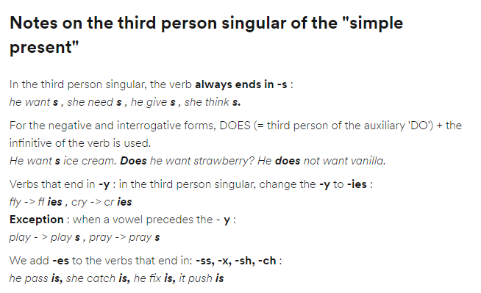

Slide 18
PASS – PASSES
CATCH- CATCHES
FIX- FIXES
PUSH- PUSHES

Slide 19
AF NEG ING
I DO I DON´T DO I?
YOU DO YOU DON´T DO YOU?
HE DOES HE DOESN´T DOES HE?
SHE DOES SHE DOESN´T DOES SHE ?
IT DOES IT DOESN´T DOES IT?
YOU DO YOU DON´T DO YOU ?
WE DO WE DON´T DO WE?
THEY DO THEY DON´T DO THEY?

Slide 20
DO I PLAY SOCCER?
DO YOU PLAY THE PIANO?
NO, I DON´T
YES, I DO
DOES MAFE STUDY MEDICINE?
YES, SHE DOES
NO, SHE DOESN´T

Slide 21
DO YOU PLAY TENNIS ?
NO, I DON´T
YES, i do
Do you watch Netflix?
Yes, I do
No, I don´t

Slide 22
NEGATIVE AND INTERROGATIVE
I LOVE READING BOOKS- I DON´T LOVE READING
ISSAC LOVES LEARNING LANGUAGES- ISSAC DOESN´T LOVE LEARNING……..
KEIMY AND JOSÉ PARTICIPATE A LOT – KEIMY AND JOSÉ DON´T PARTICIPATE A LOT

Slide 23
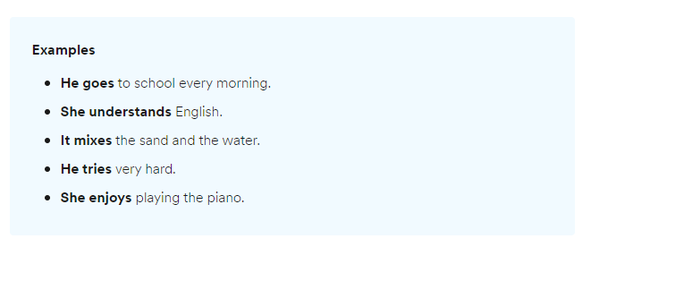

Slide 24
PASS – HE PASSES
CH: CATCH : HE CATCHES
X: FIX: SHE FIXES THE MOTORCYCLE
SH: PUSH: SHE PUSHES THE BOTTOM

Slide 25
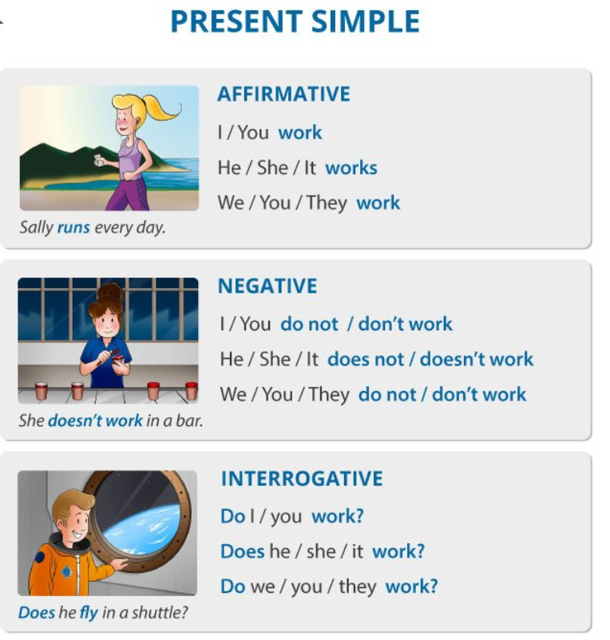
Auxiliars

Slide 26
Practice with present simple ( affirmative)
https://www.englisch-hilfen.de/en/exercises/tenses/simple_present_s.htm
https://www.englisch-hilfen.de/en/exercises/tenses/simple_present_s2.htm
https://www.english-room.com/grammar/presentsimpletense_affirmative_1.htm

Slide 27
Negative form
https://agendaweb.org/exercises/verbs/present/negative-forms-pronouns
https://agendaweb.org/exercises/verbs/present/negative-write-3.htm
https://www.english-4u.de/en/tenses-exercises/present-negation2.htm

Slide 28
Interrogative form
https://agendaweb.org/exercises/verbs/present/do-does-1
https://agendaweb.org/exercises/verbs/do-does
https://www.englisch-hilfen.de/en/exercises/questions/simple_present2.htm
https://www.englisch-hilfen.de/en/exercises/questions/simple_present.htm

